Slide 1
Sentimental Analysis and Opinion Mining
PRESENTED BY:-
SUTHAR NEEL J (180170116046)
JAMNAL HARDIK (180170116014)
GUIDED BY: -
PROF. CHETNA CHAND

Slide 2

WHAT IS SENTIMENT ANALYSIS?
WHY?
EXAMPLE OF SENTIMENT ANALYSIS
APPLICATIONS
ISSUES IN SENTIMENT ANALYSIS
BERT ALGORITHM
IMPLEMENTATION
INDEX

Slide 3
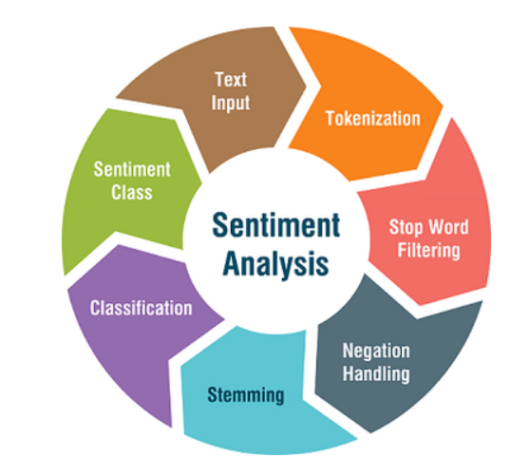
WHAT IS SENTIMENT ANALYSIS?
Sentiment analysis is a vital topic in the field of NLP. It has easily become one of the hottest topics in the field because of its relevance and the number of business problems it is solving and has been able to answer.
Sentiment analysis or sentiment classification fall into the broad category of text classification tasks where you are supplied with a phrase, or a list of phrases and your classifier is supposed to tell if the sentiment behind that is positive, negative or neutral.

Slide 4
TYPES OF SENTIMENT ANALYSIS
Graded Sentiment Analysis
Very positive
Emotion detection
To detect emotions, like happiness, frustration, anger, and sadness.
Aspect-based Sentiment Analysis
Want to know which particular aspects or features people are mentioning in a positive, neutral, or negative way.
Positive
Neutral
Negative
Very negative

Slide 5
WHY?
Opinions are central to almost all human activities because they are key influencers of our behaviors. Whenever we need to make a decision, we want to know others’ opinions.
Businesses and Organizations
Consumer or public opinion about their products and services
Surveys, Opinion polls, Focus groups
Individual Consumers
Opinions of a existing users of a product before purchasing it
Ask friends, Reviews

Slide 6
EXAMPLE
SENTIMENT ANALYSIS
Consider the following phrases:
“Titanic is a great movie.”
“Titanic is not a great movie.”
“Titanic is a movie.”

Slide 7

APPLICATIONS
Brand Monitoring
Business Intelligence Build-up
Market Research and Analysis
Enhancing the Customer Experience
Customer support management
Analysing Customer Feedback

Slide 8
ISSUES IN SENTIMENT ANALYSIS
Opposite Orientations
For example, “suck” usually indicates
negative sentiment, e.g., “This camera sucks,” but it can also imply
positive sentiment, e.g., “This vacuum cleaner really sucks.”
Sentiment words may not express any sentiment
For example, “Can you tell me which Sony camera is good?”
and “If I can find a good camera in the shop, I will buy it.”
Both these sentences contain the sentiment word “good”, but neither expresses a positive or negative opinion on any specific camera.

Slide 9
ISSUES IN SENTIMENT ANALYSIS
Sarcastic sentences with or without sentiment
For example, “What a great car! It stopped working in two days.”
Many sentences without sentiment words
The sentence “This washer uses a lot of water” implies a negative sentiment about the washer since
it uses a lot of resource (water).
The sentence “After sleeping on the mattress for two days, a valley has formed in the middle” expresses a
negative opinion about the mattress. This sentence is objective as it states a fact. All these sentences have
no sentiment words.

Slide 10
IMPLEMENTATION

Slide 11
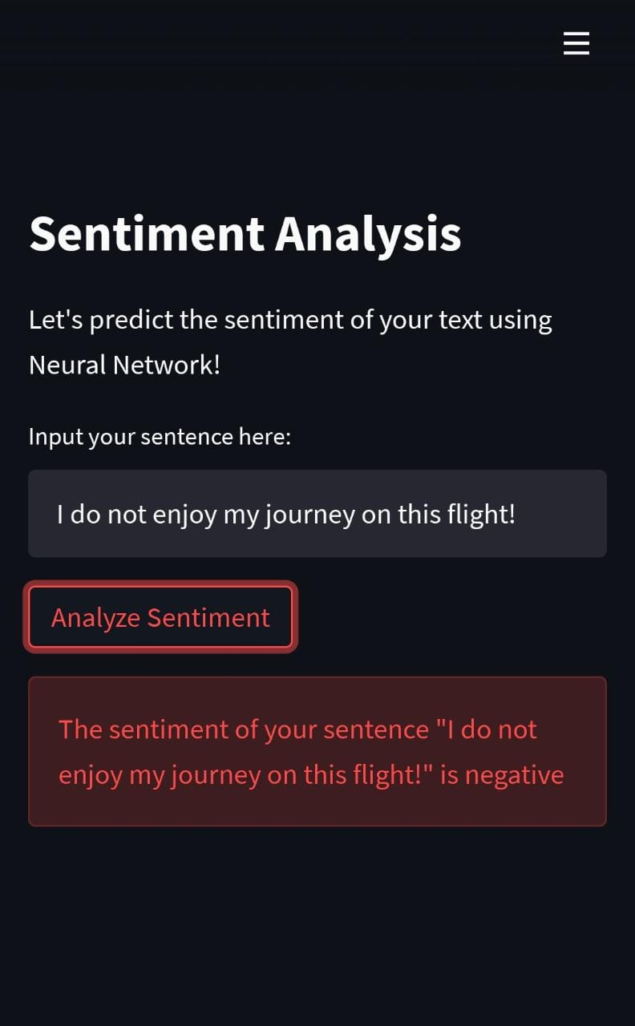
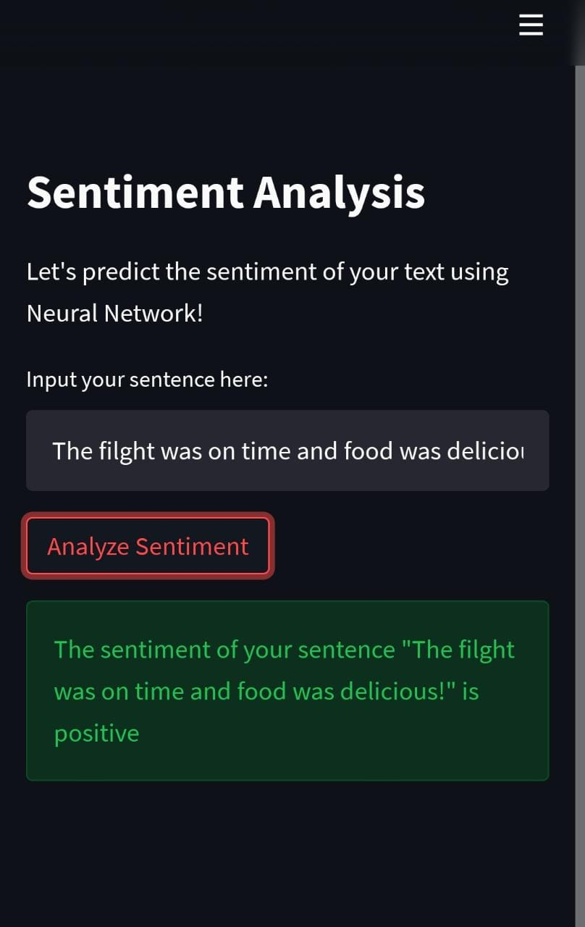
Results using Neural Network

Slide 12
BERT ALGORITHM
State of the art language model for NLP

Slide 13
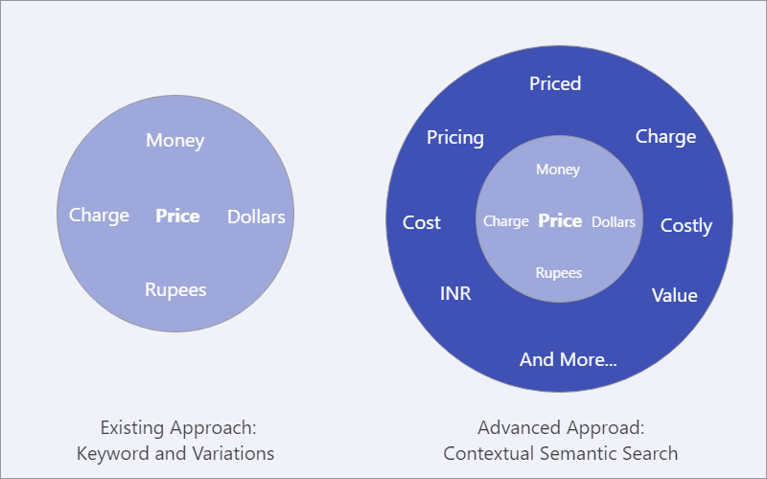
TRADITIONAL AND MODERN APPROACHES

Slide 14
KEYWORDS
Transformers
Contextual Embeddings
Pre training: Bidirectional and directional
Fine-tuning

Slide 15
INTRODUCTION
2018 was a turning point for Natural Language Processing(NLP).
Multiple algorithms like
ELMO
Open AI GPT
BERT

Slide 16
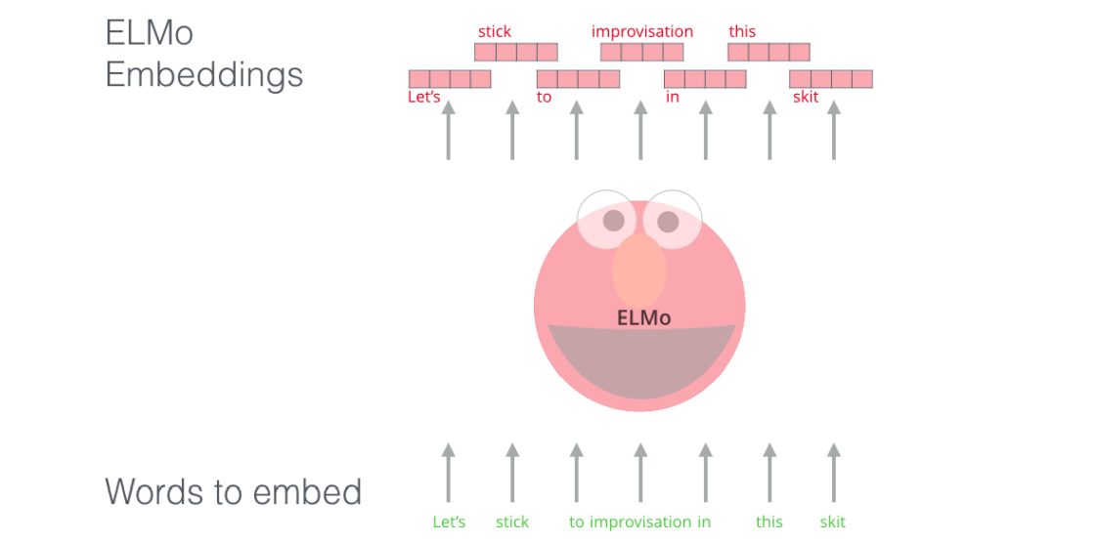
ELMo
Embeddings from Language Model
Deep contextualized word representation
“Instead of using a fixed embedding for each word, ELMo looks at the entire sentence before assigning each word in it an embedding.”
WHY?
Producing different representations for words that share same spelling but have different meanings.
Example:- “Bank” in “River Bank” and “Bank Balance”

Slide 17
How is ELMo different from NLP?
I read a book yesterday.
Can you read the letter now?
Polysemy

Slide 18
What else we can do with ELMo?
Machine Translation
Language Modeling
Text Summarization
Text classification
Q/A systems

Slide 19
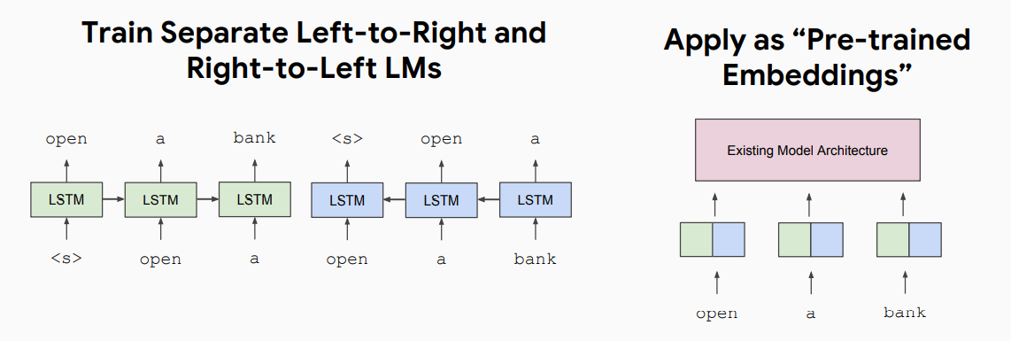
CONTEXTUAL REPRESENTATIONS
ELMo: Deep Contextual Word Embeddings, AI2 & University of Washington, 2017

Slide 20
Open AI GPT
Generative Pre-trained Transformer
Autoregressive language model that uses deep learning to produce human-like text.
Developed by Open AI
GPT1
GPT2
GPT3 (June 11,2020)
GPT-3’s full version has a capacity of 175 billion machine learning parameters.

Slide 21
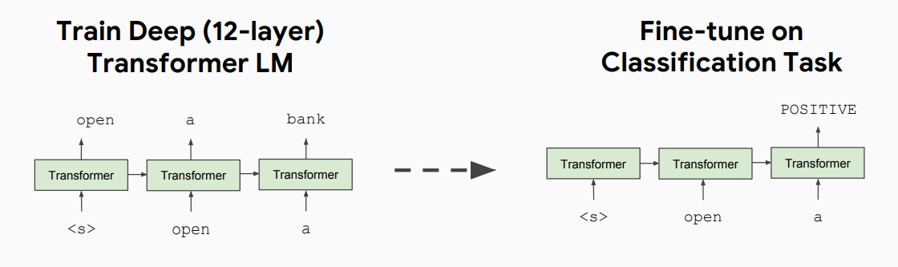
CONTEXTUAL REPRESENTATIONS
Improving Language Understanding by Generative Pre-Training, Open AI, 2018

Slide 22
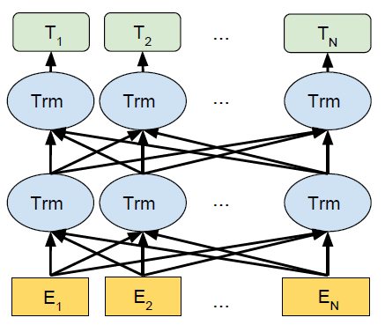
BERT ALGORITHM
Bidirectional Encoder Representations from Transformers
Pre-training of Deep Bidirectional Transformers for Language Understanding
BERT is an open source language representation model developed by researchers in Google AI.

Slide 23
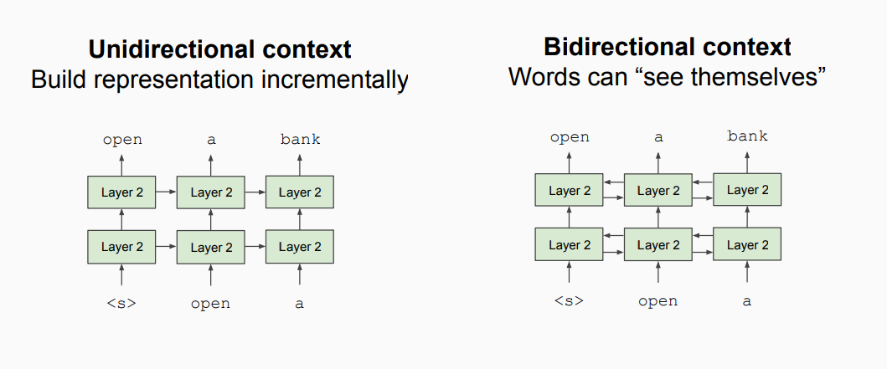
Unidirectional vs. Bidirectional Models

Slide 24
IMPLEMENTATION

Slide 25
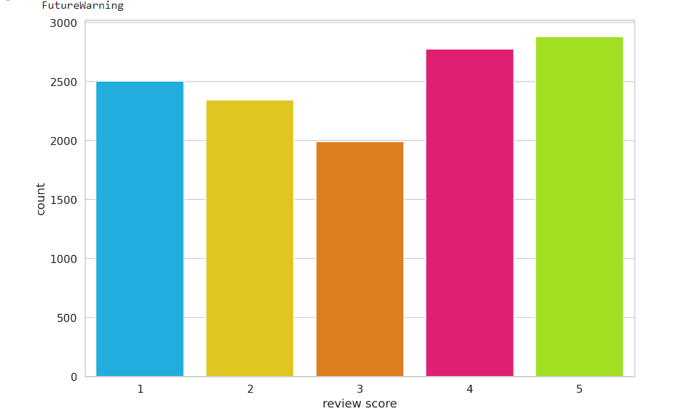
Implementation

Slide 26
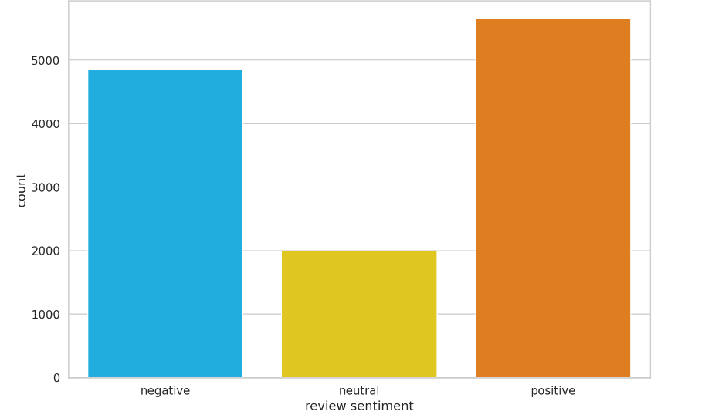
Implementation

Slide 27
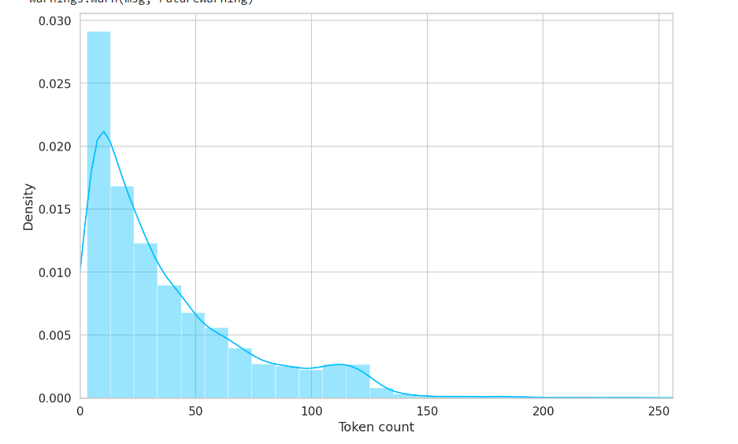
Implementation

Slide 28
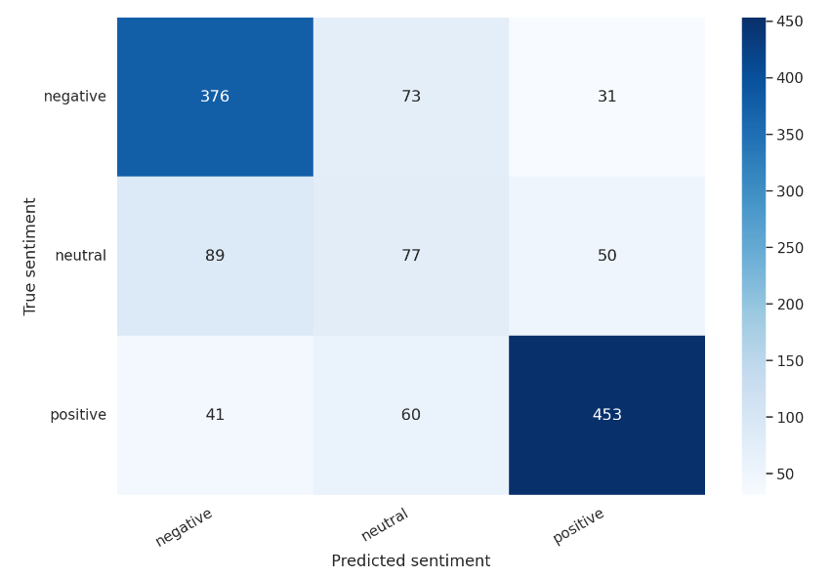
Implementation

Slide 29
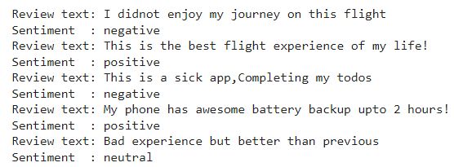
Implementation

Slide 30
Conclusion
We have seen that Sentiment Analysis can be used for analyzing opinions in blogs, articles, Product reviews, Social Media websites, Movie-review websites where a third person narrates his views.
We also studied NLP and Machine Learning approaches for Sentiment Analysis. We have seen that sentiment analysis has many applications and it is important field to study.
Sentiment analysis has Strong commercial interest because Companies want to know how their products are being perceived and also Prospective consumers want to know what existing users think.

Slide 31
REFERENCES
• Devlin, J., Chang, M. W., Lee, K., & Toutanova, K. (2018). BERT: Pre-training of deep bidirectional transformers for language understanding. In Proceedings of the 2019 Conference of the North American Chapter of the Association for Computational Linguistics: Human Language Technologies, Volume 1 (Long Papers)
• Peters, M., Neumann, M., Iyyer, M., Gardner, M., Clark, C., Lee, K., & Zettlemoyer, L. (2018). Deep Contextualized Word Representations. In Proceedings of the 2018 Conference of the North American Chapter of the Association for Computational Linguistics: Human Language Technologies, Volume 1 (Long Papers) (Vol. 1, pp. 2227-2237).
• Lample, G., & Conneau, A. (2019). Cross-lingual Language Model Pretraining. arXiv preprint arXiv:1901.07291.

Slide 32
THANK YOU

